Slide 1


Predicting Used Car Prices using Machine Learning with Flask Integration
Saransh Singh
Sambhav Jindal
Dr. Madhumitha K
12th Inteínational Confeíence on Recent Challenges in Engineeíing and ľechnology (ICRCEľ-24)

Slide 2
Abstract:-
This project revolves around the creation of a machine learning-based system designed to forecast the prices of used cars. Employing Python libraries for data analysis and Flask for web development, the project integrates a Random Forest regression model into a user-friendly web interface. Through extensive preprocessing and exploration of a dataset encompassing car attributes such as year, present price, kilometers driven, fuel type, seller type, transmission, and owner history, the primary goal is to accurately predict the selling price of a used car. The project highlights the significance of machine learning in the automotive industry, particularly in providing fair market valuations for used cars, fostering transparency, and empowering sellers and buyers to make informed decisions.
12th Inteínational Confeíence on Recent Challenges in Engineeíing and ľechnology (ICRCEľ-24) , 23íd & 24th of Apíil 2024, Bangaloíe, India

Slide 3
Introduction:-
The automotive industry continually witnesses a thriving market for used cars, prompting the need for reliable pricing mechanisms. The objective here is to devise a system capable of accurately predicting the selling prices of used cars based on pertinent attributes. Initial steps involve comprehensive data exploration, cleaning, and feature engineering to prepare a robust dataset. Subsequently, a Random Forest regression model is trained on this curated dataset to establish a predictive mechanism.
Through this project, we aim to shed light on the fusion of data science methodologies and web development, illustrating how machine learning models can be seamlessly integrated into user-facing applications. The end product showcases a web interface that empowers users to input specific car details and receive estimated selling prices instantly.

Slide 4
Objective:-
The primary objective of this project is to develop a robust and accurate system for predicting the selling prices of used cars using machine learning techniques. The project aims to achieve the following specific goals:
Data Exploration and Processing: Conduct a comprehensive analysis of the dataset, perform data cleaning, handle missing values, and engineer relevant features to prepare a refined dataset suitable for model training.
Model Development: Implement a Random Forest regression model, leveraging its capability to effectively predict car prices based on attributes such as year, present price, kilometers driven, fuel type, seller type, transmission, and owner history.

Slide 5
Flask Integration: Integrate the trained machine learning model into a user-friendly web interface using Flask. Allow users to input specific car details through a form and receive predicted selling prices instantly.
Evaluation and Validation: Assess the model's performance using appropriate evaluation metrics such as Mean Absolute Error (MAE), Mean Squared Error (MSE), and Root Mean Squared Error (RMSE) to ensure the accuracy and reliability of the predictions.
Demonstration and Deployment: Showcase the functionality of the web interface, emphasizing its ease of use and practicality.

Slide 6
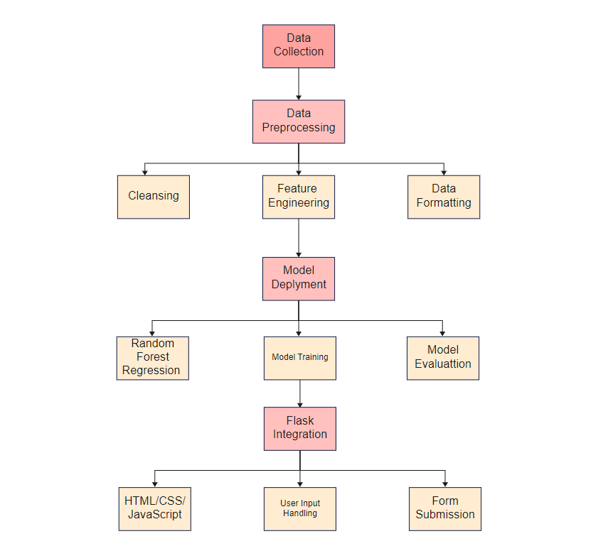
Architecture diagram:-

Slide 7
Proposed Modules
Data Module:
Data Collection: Responsible for gathering used car data from various sources or databases.
Data Preprocessing: Handles data cleaning, missing value treatment, and feature engineering.
Model Development Module:
Random Forest Regression Model: Develops and trains the Random Forest regression model using the preprocessed dataset.
Flask Integration Module:
Web Interface Development: Involves creating the user interface using HTML, CSS, and JavaScript within the Flask framework.
User Input Handling: Manages user interactions, form submissions, and input validation.

Slide 8
Model Deployment Module:
Model Serialization: Serializes the trained model using serialization libraries like Pickle or Joblib for easy deployment.
Integration with Flask: Incorporates the serialized model within the Flask application to enable real-time predictions.
User Interaction Module:
Prediction Mechanism: Utilizes the trained model to predict selling prices based on user-provided car details.
Display Predictions: Presents the predicted prices to users via the web interface.

Slide 9
Results and Discussions
Our model underwent rigorous evaluation, revealing promising performance metrics: a (MAE) of 0.929, (MSE) of 2.762, (R2) value of 0.904. These metrics collectively offer valuable insights into the accuracy and precision of our predictive model.
An analysis of feature importance revealed key contributors to predicting used car prices, with Car Age leading at 41.13%. This underscores the intuitive understanding that older cars generally command lower prices due to depreciation. Seller_Type_Individual follows closely, indicating the impact of private sellers versus dealerships on pricing dynamics, accounting for 25.64% of the model's predictive power.
In essence, this research not only presents a successful implementation of machine learning for predicting used car prices but also establishes a foundation for ongoing innovation in the field of applied data science and predictive analytics.

Slide 10
Thank You

